Slide 1
Viksit Bharat @2047
SwasthyaSathi AI: A Proposed AI-Assisted Platform for Health Awareness and Misinformation Literacy in India
Knowledge Beyond the Search Bar: How Artificial Intelligence Can Support Health Awareness, Counter Misinformation and Promote Community Well-Being in India
  Theme: Health, Culture and Community Well-Being
  Presented by: Ishita Singh
  Programme: B.Tech Bioinformatics, ITCPS
01

Slide 2
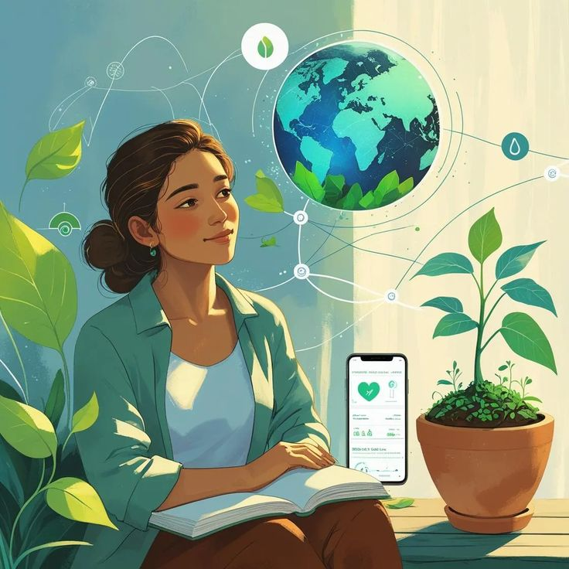
Introduction
  Digital platforms have transformed how people access health information. Search engines, social media and messaging applications make health-related content widely available. However, the reliability, clarity and accuracy of this information can vary.
  SwasthyaSathi AI is an idea that explores how an AI-assisted digital platform could help users navigate understandable health information, access credible sources and critically evaluate online health claims.
  The project presents a proposed concept supported by a preliminary website prototype.
02

Slide 3
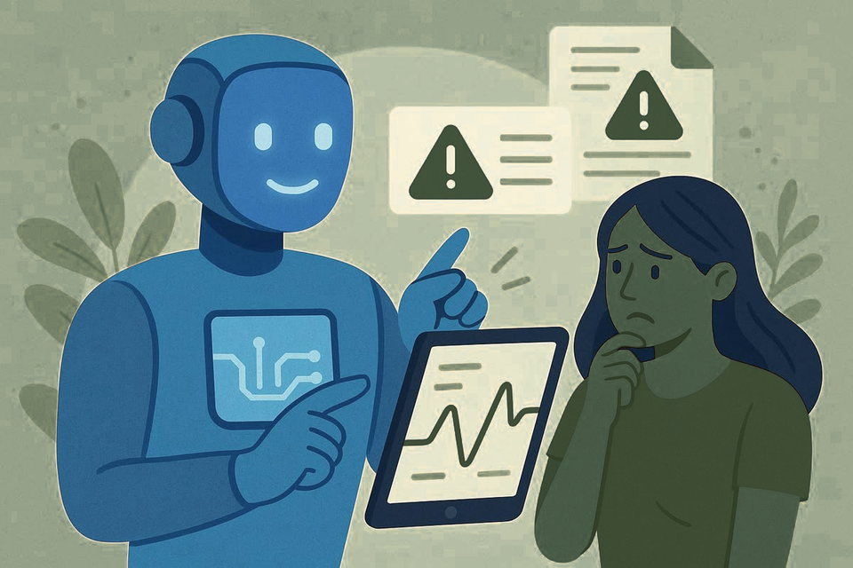
Problem Statement
Health Information in the Digital Age
  Growing dependence on online platforms for health information.
  Rapid circulation of misleading health claims and unverified remedies.
  Complex medical language creates barriers to understanding.
  Language and digital-literacy gaps affect access to reliable information.
  Need for accessible, trustworthy and understandable health education.
03

Slide 4
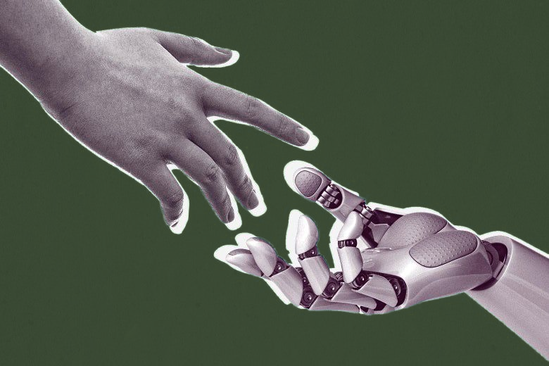
How Can AI Help?
Artificial Intelligence for Health Awareness -
  Simplification: Converts complex health information into easier language.
  Multilingual access: Supports communication in languages such as Hindi and English.
  Source discovery: Helps users locate credible health information.
  Claim assessment: Can support examination of health claims against reliable sources.
  Responsible use: Must account for inaccurate outputs, bias and the need for human expertise.
Technology should complement existing healthcare services rather than replace them.
04

Slide 5

Aim & Proposed Approach
Aim: To propose an AI-assisted approach to accessible health awareness and health-misinformation literacy in India.
Objectives -
  Improve the accessibility and understandability of health information.
  Encourage verification of online health claims.
  Support Hindi- and English-speaking users.
  Promote responsible AI use in community health education.
Approach -
Curated health resources + AI-assisted communication + clear source links + safety guidance.
05

Slide 6

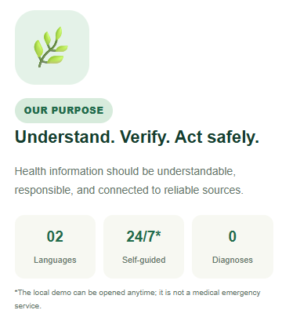
Introducing SwasthyaSathi AI
A Proposed Digital Health-Awareness Platform
SwasthyaSathi AI is a proposed mobile-friendly website designed to help users access and understand general health information.
Core principles -
  Simple, accessible health education.
  Hindi and English language support.
  Information linked to trusted sources.
  Responsible AI use with clear safety boundaries.
Purpose: To help people make more informed decisions about health information without replacing qualified healthcare professionals.
06

Slide 7

Key Features
Health Guide
  Easy-to-understand general health information.
  Links to trusted health resources.
  Intended to support everyday health awareness.
.Health Claim Checker
  Proposed feature to help users examine health claims.
  Intended to guide users towards credible sources.
  Requires reliable source matching and further validation.
07

Slide 8
Website Prototype Overview
A Proposed Digital Health-Awareness Platform
Demonstration Topics -
  Homepage and platform purpose.
  Health Guide or one working information feature.
  Trusted-source links and safety guidance.
SwasthyaSathi AI | Health Awareness For Everyone.
Prototype note: This is a preliminary demonstration of the proposed concept, not a clinically validated health tool.
08

Slide 9
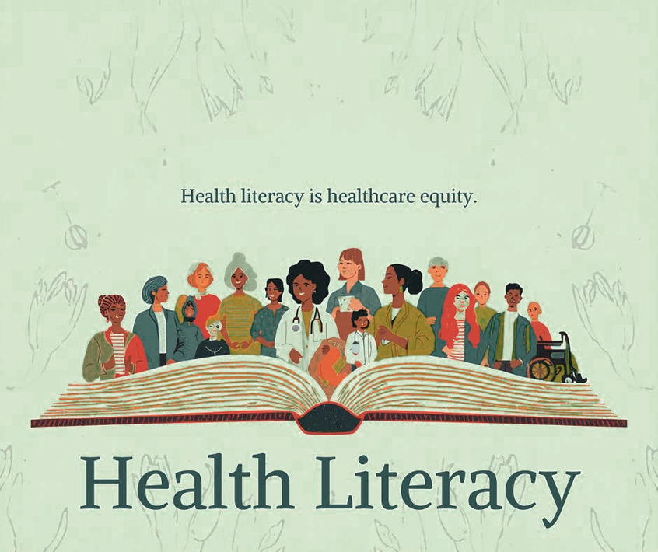
Expected Impact for India
Supporting Community Health Awareness
  Health literacy: Easier access to understandable health information.
  Misinformation awareness: Encourages users to question and verify online claims.
  Language accessibility: Supports information access in Hindi and English.
  Informed communities: Encourages more responsible health-information sharing.
  Viksit Bharat @2047: Contributes to the vision of inclusive, digitally enabled community well-being.
10

Slide 10

Limitations & Future Scope
Current limitations
  AI-generated information may be inaccurate or incomplete.
  Health resources require regular review and updating.
  Language accessibility does not guarantee equal understanding.
  The prototype requires systematic evaluation.
Future scope
  Expert review of health content.
  More Indian-language support.
  Privacy-conscious design and user feedback.
  Testing for accuracy, usability and misinformation-handling performance.
Safety principle: The platform should educate and guide users towards reliable resources, not diagnose conditions or prescribe treatment.
11

Slide 11

Conclusion
From Information Access to Informed Awareness
  AI offers opportunities to make health information more accessible.
  Reliable sources and responsible design are essential.
  SwasthyaSathi AI proposes a practical approach to health awareness and misinformation literacy.
  Further development, expert review and evaluation are needed.
12

Slide 12
Thank You
“AI should not replace medical expertise; it should help people find, understand and question health information responsibly.”
Presented by:
Ishita Singh
13

